Slide 1
SDMX
Content Constraints
March 2025
Edgardo Greising

Slide 2
Constraints
There are two types of Constraints: DataConstraint and MetadataConstraint
A constraint is used to:
  further restrict a code list by defining a subset of allowed or forbidden values (CubeRegion & MetadataTargetRegion)
  define allowed or forbidden full or partial series’ keys (DataKeySet)
  define a validity period for the constrained artefact
  establish a ReleaseCalendar
  define slices of the full set of data and to which metadata can be attached in a dataset or metadata set (AttachmentConstraint)
    → Deprecated in SDMX 3.0.0 due to the lack of use cases
Notes:
For instance, a DataStructureDefinition specifies, for each Dimension, the list of allowable code values. However, a specific Dataflow that uses the DataStructureDefinition may contain only a subset of the possible range of keys that is theoretically possible from the DataStructureDefinition definition (the total range of possibilities is sometimes called the Cartesian product of the dimension values). In addition to this, a DataProvider that is capable of supplying data according to the Dataflow has a ProvisionAgreement, and the DataProvider may also wish to supply constraint information which may further constrain the range of possibilities in order to describe the data that the provider can supply. It may also be useful to describe the content of a data source in terms of the KeySets or CubeRegions contained within it.
A DataConstraint has a choice of two ways of specifying value subsets:
As a set of keys that can be present in the DataSet (DataKeySet). Each DataKey specifies a number of ComponentValues each of which reference a Component (e.g., Dimension, DataAttribute). Each ComponentValue is a value that may be present for a Component of a structure when contained in a DataSet. In addition, each DataKeySet may also include MemberSelections for AttributeComponents or Measures.
As a set of CubeRegions each of which defines a “slice” of the total structure (MemberSelection) in terms of one or more MemberValues that may be present for a Component of a structure when contained in a DataSet.
The difference between (1) and (2) above is that in (1) a complete key is defined whereas in (2) above the “slice” defines a list of possible values for each of the Components but does not specify specific key combinations.

Slide 3
Constraints
ContentConstraints are semantically split in two roles:
  Allowed ContentConstraint: to describe the allowed values that DSD dimensions may take within datasets
  Actual ContentConstraint: to present the actual data that an organisation has available in an SDMX web service
  → Maintainable artefact deprecated in SDMX 3.0.0
    Can no longer be maintained in a Registry
    it is always a response to the data availability SDMX REST API query.

Slide 4
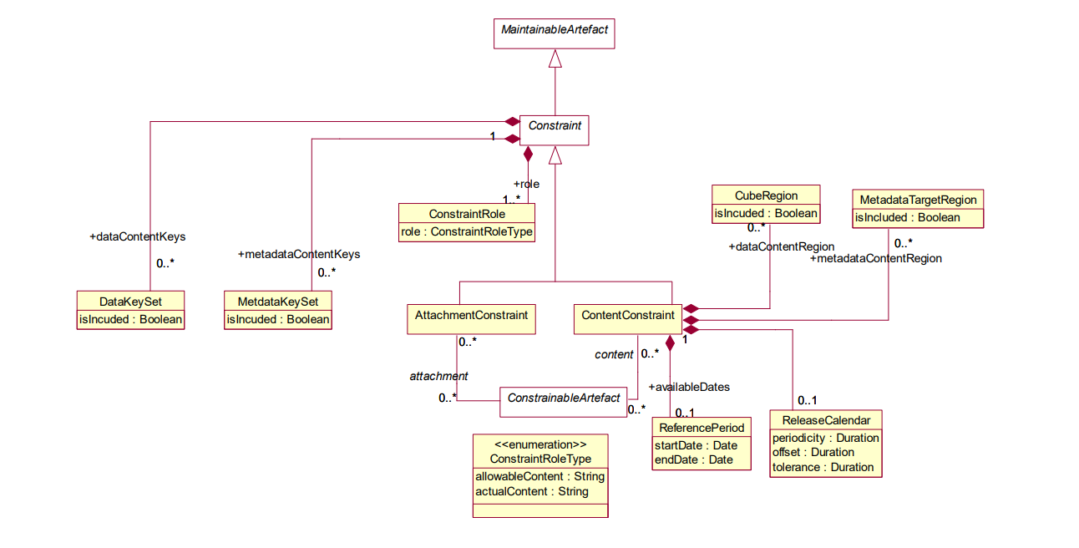
Constraints in SDMX 2.1

Slide 5
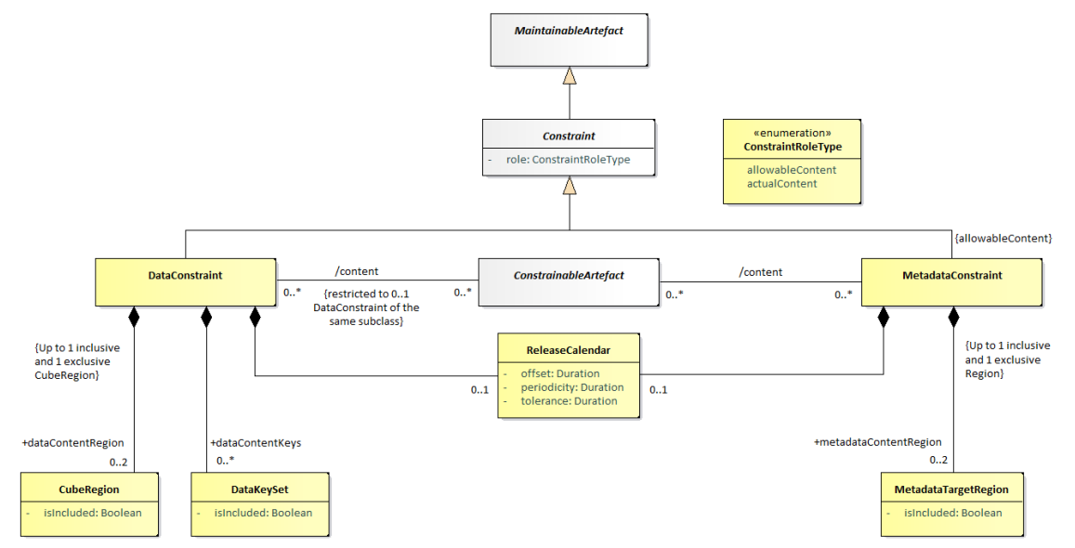
Constraints in SDMX 3.0.0

Slide 6
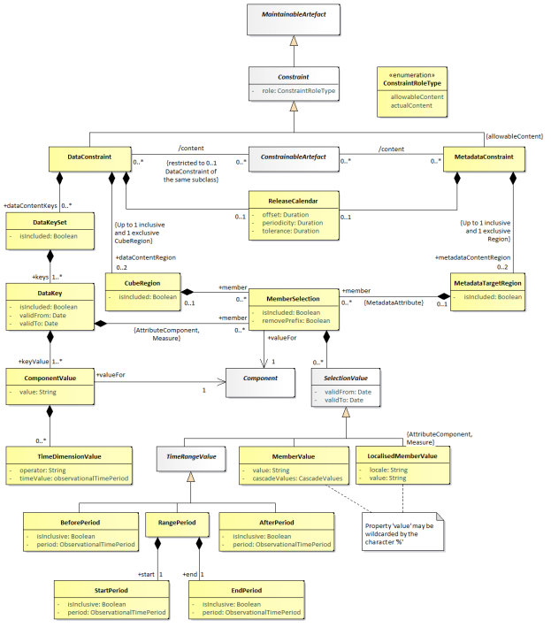
Constraints in SDMX 3.0.0 - Detail

Slide 7
Constraints’ characteristics
The Constraint “references” the constrained artefact
  Dataflow, DSD, ProvisionAgreement, DataProvider, Metadataflow, MSD, MetadataProvisionAgreement
No artefact references a Constraint
  the latest stable versions of Constraints per Constrainable artefact are taken as effective Constraints.
Since SDMX 3.0.0 Attributes and Measures are allowed in DataKeySets, within each KeySet.
The character “%” wildcards any 0…n character(s)
  to the right part of a specified prefix,
  any other part of a Value expression
  includes all items matching that pattern.

Slide 8
Constraints’ characteristics
It is possible to define for the DataKeySet, DataKey, CubeRegion, MetadataTargetRegion and MemberSelection whether the set is included (isIncluded = "true", default) or excluded (isIncluded = "false") from the Constraint definition
cascadeValues specifies that child values (e.g., child items in a codelist) are included in the Constraint
  It may take the following values:
    "true": all children are included,
    "false" (default), no cascading
    "excludeRoot", where all children are included, but the root Code is excluded (i.e. the referenced Code)

Slide 9
Constraints’ characteristics
It is possible to remove a prefix that has been used to group items in a codelist (e.g. for a classification variant) with the property removePrefix,
In DataKeys and MemberValues it is possible, via the validFrom and validTo properties to set a validity period for which the selected key or value is constrained.

Slide 10
Constraints’ examples
Allow EU country codes before and after Brexit
  A PA has a ContentConstraint with:
    isIncluded = true
    KeyValue id=REF_AREA
      Value = “AT, BE, BG, CY, CZ, DE, DK, EE, ES, FI, FR, GB, GR, HR, HU, IE, IT, LT, LU, LV, MT, NL, PL, PT, RO, SE, SI, SK”
      TimeDimensionValue operator=LE timeValue=2020-01-31
      to include GB until the Brexit effective date
    KeyValue id=REF_AREA
      Value = “AT, BE, BG, CY, CZ, DE, DK, EE, ES, FI, FR, GR, HR, HU, IE, IT, LT, LU, LV, MT, NL, PL, PT, RO, SE, SI, SK”
      TimeDimensionValue operator=GE timeValue=2020-02-01
      to remove GB data as from the Brexit effective date
  Data submission under this PA will validate the pertinence of including GB data or not depending on the reference period

Slide 11
Constraints’ examples
Remove a prefix that has been used to group items in a codelist for a classification variant
  The CL_ECO codelist contains ISIC and NACE variants with the original codes prefixed with the variant id, like “ISIC4_”, “ISIC3_”, “NACE2_”, etc. to avoid code conflicts.
  A DF that uses ISIC Rev 4 has a specific ContentConstraint with:
    isIncluded = true
    KeyValue id=ECO
      Value=“ISIC4_%”, to include all items of the ISIC Rev 4 variant
      removePrefix=“ISIC4_”, to get the original codes
  A data query for the DF will include only data with the economic activity classified according to ISIC Rev. 4
  A structure query for the DF with references=descendants and detail=referencepartial will return CL_ECO with the constraints applied including only the items of the selected variant ISIC Rev.4

Slide 12



